Slide 1
GeBIZ tender award prediction

Slide 2

GeBIZ - Government Electronic Business
Singapore’s public sector e-procurement portal
Why do private companies use it?
Pros:
  Good business opportunities
  Low counterparty risk
Cons:
  Highly competitive
  Tender documents can be long and detailed

Slide 3

Costs to tendering for a project on GeBIZ
Man hours spent on examining tender documents
  Domain knowledge is important
  Task is difficult to delegate or oversee
  Senior staff member needed
Possible outcomes
  Company is unable to tender at a competitive price
  Tender but loses to a competitor
  Wins the tender
Loss of productivity

Slide 4

Using machine learning to predict award
Screening tool
Estimate award price right at the start
Aid productivity
Instead of asking the question, “How much does it cost us to do this job?”
Allows the user to ask, “Can we do this job at $X?”

Slide 5
Gathering and cleaning the data
Dataset available from data.gov.sg
Search “Government Procurement via GeBIZ”
Shape: 32756 x 7
Column names | tender no. | tender description | agency | award date | tender detail status | supplier name | awarded amt
Data type / action | To be dropped | Text, apply NLP | Categorical, further EDA needed | Numerical, discrete, formatted to yyymmdd | Categorical, further EDA needed | To be dropped | Target variable, continuous, further EDA needed

Slide 6
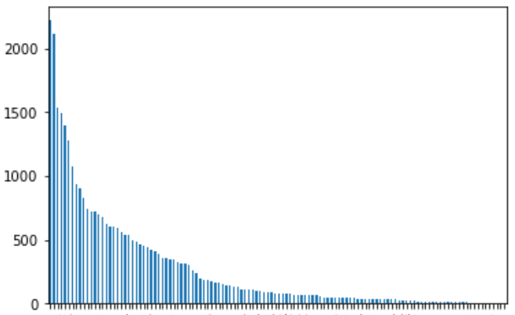
Exploratory Data Analysis
“agency” column
Categorical data
High cardinality, 122 categories
Try to reduce number of categories
Record Count
Agencies

Slide 7
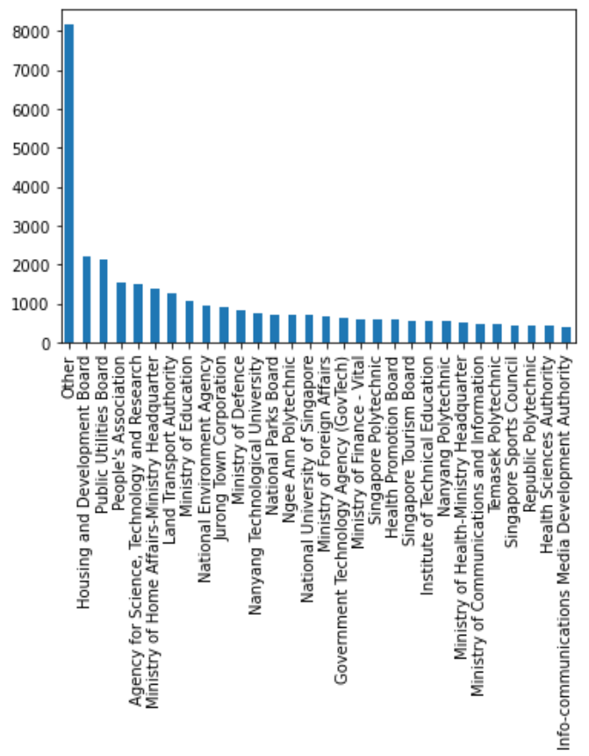
Exploratory Data Analysis
“agency” column
Arrange according to most frequent agency in descending order.
Least frequent 25% records renamed as “Other”
Categories reduced to 30
Record Count

Slide 8

Exploratory Data Analysis
“Tender_detail_status” column
3 categories:
Ordinal data,
  “Awarded to No suppliers” replaced with 0
  “Awarded to Suppliers” replaced with 1
  “Awarded by Items” replaced with 2

Slide 9
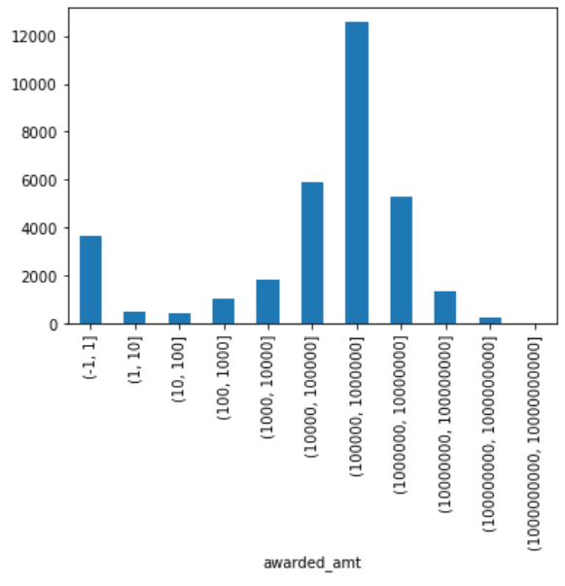
Exploratory Data Analysis
“awarded_amt” column, target variable
Wide range, between 0 to 10¹⁰
Mostly centered between 10⁵ to 10⁶
Create new column “bin” then stratify by “bin” when doing train test split.
Record Count

Slide 10
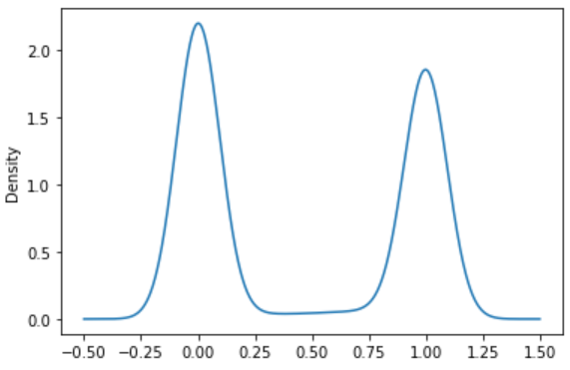
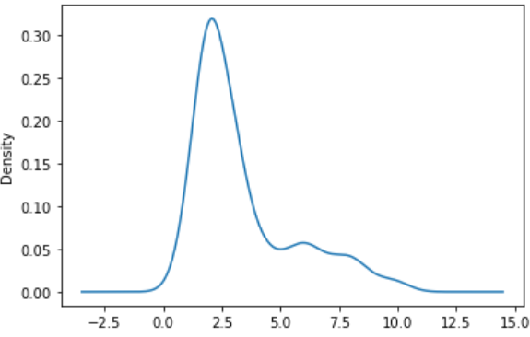
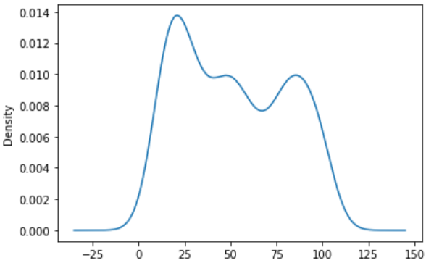
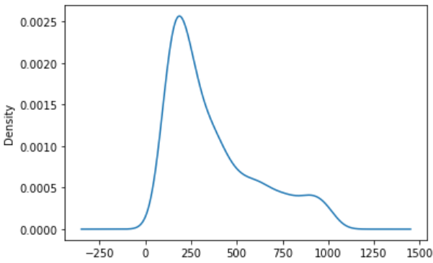
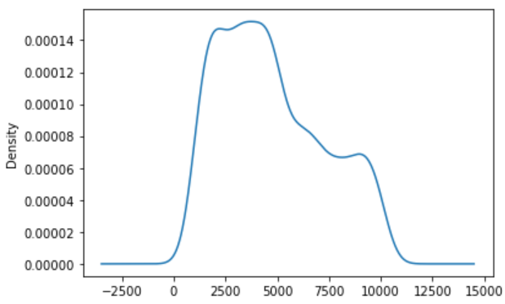
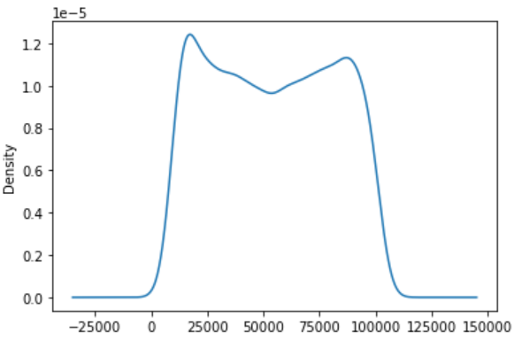
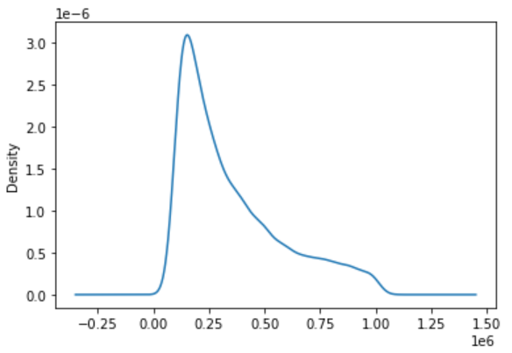
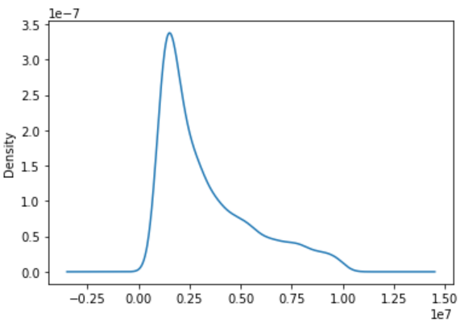
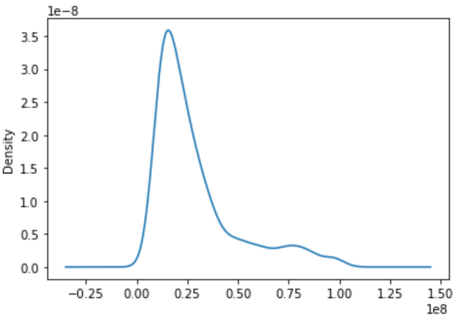
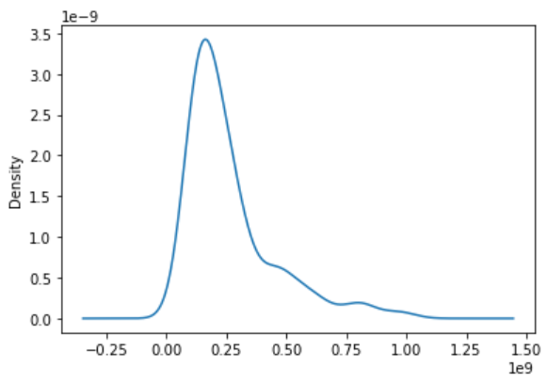
Exploratory Data Analysis
“awarded_amt” density by log range
0 to 1
1 to 10
10 to 10²
10² to 10³
10³ to 10⁴
10⁴ to 10⁵
10⁵ to 10⁶
10⁶ to 10⁷
10⁷ to 10⁸
10⁸ to 10⁹

Slide 11
NLP feature sets
“tender_description” column
Basic features, “char_count”, “word_count”, “word_density”, “adj_count”, “adv_count”, “noun_count”, “num_count”, “pron_count”, “propn_count”, “verb_count”
Count vector by word
TF-IDF by word
TF-IDF by word, 2, 3 ngram
TF-IDF by character, 2, 3 ngram

Slide 12
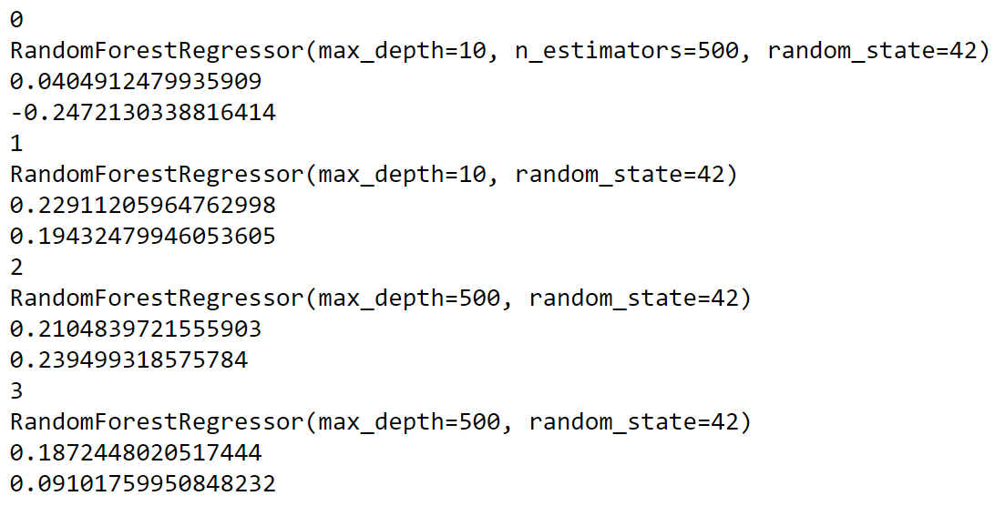
Random Forest Regressor
Basic NLP features
Count vectors by word
TF-IDF by character 2,3 ngrams did not finish
TF-IDF by word
TF-IDF by word 2, 3 ngrams

Slide 13

Comparison with Linear Regression
Model is worse than baseline when Linear Regression is used.

Slide 14
Possible improvements
Deep learning?
Tfidf vectorizer capped at 5000 features. Remove cap?
Exclude the 7 outliers
Create a pipeline of different models based on density curve
Model for left-skewed bin
Classifier using with “tender_status_detail” as target variable
Model for valley bin

